Slide 1
Quicksort
Many slides borrowed from David Kauchak

Slide 2
Heap Sort
Like merge sort, it’s running time is O(nlogn)
It sorts in place.

Slide 3
QuickSort
Uses Divide and Conquer approach
Best case is O(nlogn)
Worst case is O(n²)
On average, it is faster than the heapsort, due to a highly optimized inner loop.

Slide 4
QuickSort
Quicksort sorts by employing a divide and conquer strategy to divide a list into two sub-lists.
The steps are:
  Pick an element, called a pivot, from the list.
  Reorder the list so that all elements which are less than the pivot come before the pivot and all elements greater than the pivot come after it (equal values can go either way). After this partitioning, the pivot is in its final position. This is called the partition operation.
  Recursively sort the sub-list of lesser elements and the sub-list of greater elements.
  The base case of the recursion are lists of size zero or one, which are always sorted.

Slide 5
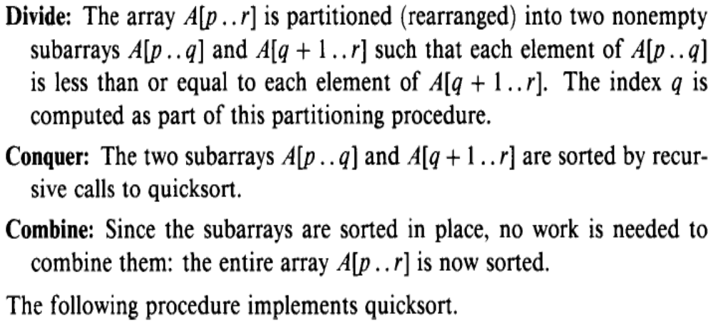
QuickSort:
More formally: for an array A[p .. r]:

Slide 6
QuickSort
Some points:
  Base case includes the possibility that the set A might be empty.
  Algorithm allows any number to be a pivot.
  The pivot divides the set into two subsets:
    The left subset contains values smaller than the pivot
    The right subset contains values greater than the pivot.
  Obviously some choice for pivot are better than others.

Slide 7
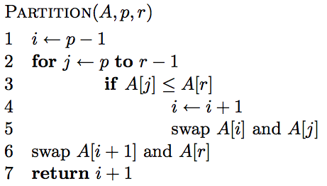
What does it do?

Slide 8
A[r] is called the pivot
Partitions the elements A[p…r-1] in to two sets, those ≤ pivot and those > pivot
Operates in place
Final result:
p
pivot
r
A
≤ pivot
> pivot

Slide 9
… 5 7 1 2 8 4 3 6 …
p
r

Slide 10
i
… 5 7 1 2 8 4 3 6 …
p
r

Slide 11
i
j
… 5 7 1 2 8 4 3 6 …
p
r

Slide 12
i
j
… 5 7 1 2 8 4 3 6 …
p
r

Slide 13
i
j
… 5 7 1 2 8 4 3 6 …
p
r

Slide 14
i
j
… 5 7 1 2 8 4 3 6 …
p
r

Slide 15
i
j
… 5 7 1 2 8 4 3 6 …
p
r

Slide 16
i
j
… 5 7 1 2 8 4 3 6 …
p
r

Slide 17
i
j
… 5 7 1 2 8 4 3 6 …
p
r

Slide 18
i
j
… 5 1 7 2 8 4 3 6 …
p
r

Slide 19
i
j
… 5 1 7 2 8 4 3 6 …
p
r

Slide 20
i
j
… 5 1 7 2 8 4 3 6 …
p
r

Slide 21
i
j
… 5 1 2 7 8 4 3 6 …
p
r

Slide 22
i
j
… 5 1 2 7 8 4 3 6 …
p
r

Slide 23
i
j
… 5 1 2 7 8 4 3 6 …
p
r
What’s happening?

Slide 24
i
j
… 5 1 2 7 8 4 3 6 …
p
r
≤ pivot
> pivot
unprocessed

Slide 25
i
j
… 5 1 2 7 8 4 3 6 …
p
r

Slide 26
i
j
… 5 1 2 4 8 7 3 6 …
p
r

Slide 27
i
j
… 5 1 2 4 3 7 8 6 …
p
r

Slide 28
i
j
… 5 1 2 4 3 6 8 7 …
p
r

Slide 29
i
j
… 5 1 2 4 3 6 8 7 …
p
r

Slide 30
Is Partition correct?
Partitions the elements A[p…r-1] in to two sets, those ≤ pivot and those > pivot?
Loop Invariant:

Slide 31
Partition running time?
Θ(n)

Slide 32
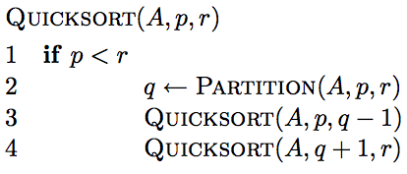
Quicksort

Slide 33
8 5 1 3 6 2 7 4

Slide 34
8 5 1 3 6 2 7 4

Slide 35
1 3 2 4 6 8 7 5

Slide 36
1 3 2 4 6 8 7 5

Slide 37
1 3 2 4 6 8 7 5

Slide 38
1 2 3 4 6 8 7 5

Slide 39
1 2 3 4 6 8 7 5

Slide 40
1 2 3 4 6 8 7 5

Slide 41
1 2 3 4 6 8 7 5

Slide 42
1 2 3 4 6 8 7 5

Slide 43
1 2 3 4 5 8 7 6
What happens here?

Slide 44
1 2 3 4 5 8 7 6

Slide 45
1 2 3 4 5 8 7 6

Slide 46
1 2 3 4 5 6 7 8

Slide 47
1 2 3 4 5 6 7 8

Slide 48
Some observations
Divide and conquer: different than MergeSort – do the work before recursing
How many times is/can an element selected for as a pivot?
What happens after an element is selected as a pivot?
1 3 2 4 6 8 7 5

Slide 49
Exercises
7.1-1 Using Figure 7.1 as a model, illustrate the operation of PARTITION on the array A={13; 19; 9; 5; 12; 8; 7; 4; 21; 2; 6; 11}
7.1-2 What value of q does PARTITION return when all elements in the array A[p..r] have the same value?
7.1-4 How would you modify QUICKSORT to sort into non increasing order?
7.2-2 What is the running time of QUICKSORT when all elements of array A have the same value?

Slide 50
Analysis of quicksort—best case
Suppose each partition operation divides the array almost exactly in half
Then the depth of the recursion in log₂n
  Because that’s how many times we can halve n
However, there are many recursions!
  How can we figure this out?
  We note that
    Each partition is linear over its subarray
    All the partitions at one level cover the array

Slide 51
Partitioning at various levels

Slide 52
Best case II
We cut the array size in half each time
So the depth of the recursion in log₂n
At each level of the recursion, all the partitions at that level do work that is linear in n
O(log₂n) * O(n) = O(n log₂n)
Hence in the average case, quicksort has time complexity O(n log₂n)
What about the worst case?

Slide 53
Worst case
In the worst case, partitioning always divides the size n array into these three parts:
  A length one part, containing the pivot itself
  A length zero part, and
  A length n-1 part, containing everything else
We don’t recur on the zero-length part
Recurring on the length n-1 part requires (in the worst case) recurring to depth n-1

Slide 54
Worst case partitioning

Slide 55
Example: Assume in this and the next slide that first element is considered as the pivot. Worst Case Call Tree (N=4)
S =[ 1,3,5,7 ]
Q(1,4)
Left=1, pivotitem = 1, Right =4
Q(1,0)
Q(2,4)
Left =2,pivotItem=3
S =[ 3,5,7 ]
Q(2,1)
Q(3,4)
pivotItem = 5, Left = 3
S =[ 5,7 ]
Q(3,2)
Q(4,4)
S =[ 7 ]
Q(4,3)
Q(5,4)
QuickSort <number>

Slide 56
Worst Case Intuition
n-1
n-1
t(n) =
0
n-2
n-2
0
n-3
n-3
0
n-4
n-4
.
.
.
0
1
1
0
0
0
QuickSort <number>

Slide 57
Worst case for quicksort
In the worst case, recursion may be n levels deep (for an array of size n)
But the partitioning work done at each level is still n
O(n) * O(n) = O(n²)
So worst case for Quicksort is O(n²)
When does this happen?
  There are many arrangements that could make this happen
  Here are two common cases:
    When the array is already sorted
    When the array is inversely sorted

Slide 58
Typical case for quicksort
If the array is sorted to begin with, Quicksort is terrible: O(n²)
It is possible to construct other bad cases
However, Quicksort is usually O(n log₂n)
The constants are so good that Quicksort is generally the fastest algorithm known
Most real-world sorting is done by Quicksort

Slide 59
Picking a better pivot
Before, we picked the last element of the subarray to use as a pivot
  If the array is already sorted, this results in O(n²) behavior
  It’s no better if we pick the first element
We could do an optimal quicksort (guaranteed
O(n log n)) if we always picked a pivot value that exactly cuts the array in half
  Such a value is called a median: half of the values in the array are larger, half are smaller
  The easiest way to find the median is to sort the array and pick the value in the middle (!)

Slide 60
Median of three
Obviously, it doesn’t make sense to sort the array in order to find the median to use as a pivot
Instead, compare just three elements of our (sub)array—the first, the last, and the middle
  Take the median (middle value) of these three as pivot
  It’s possible (but not easy) to construct cases which will make this technique O(n²)

Slide 61
Example: Median-of-three Partitioning
  Let input S = {6, 1, 4, 9, 0, 3, 5, 2, 7, 8}
  left=1 and S[left] = 6
  right=10 and S[right] = 8
  center = (left+right)/2 = 5 and S[center] = 0
  Pivot
    = Median of S[left], S[right], and S[center]
    = median of 6, 8, and 0
    = S[left] = 6

Slide 62
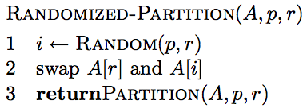
Another way to avoid the worst case?
Inject randomness into the data

Slide 63
What is the running time of randomized Quicksort?
Worst case?
Still could get very unlucky and pick “bad” partitions at every step
O(n²)

Slide 64
Final comments
Quicksort is the fastest known sorting algorithm
It is NOT stable
For optimum efficiency, the pivot must be chosen carefully
“Median of three” is a good technique for choosing the pivot
However, no matter what you do, there will be some cases where Quicksort runs in O(n²) time

Slide 65
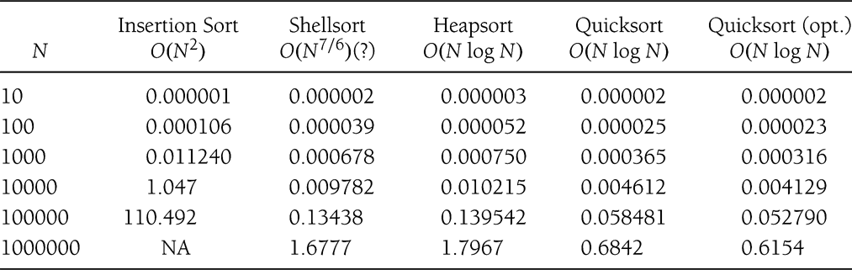
Comparison Sorting
Good sorting applets
http://www.cs.ubc.ca/~harrison/Java/sorting-demo.html
http://math.hws.edu/TMCM/java/xSortLab/
Sorting benchmark: http://sortbenchmark.org/
Cpt S 223. School of EECS, WSU
Notes:
Cpt S 223
Washington State University

Slide 66
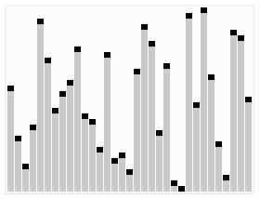
QuickSort: visualization

